Slide 1
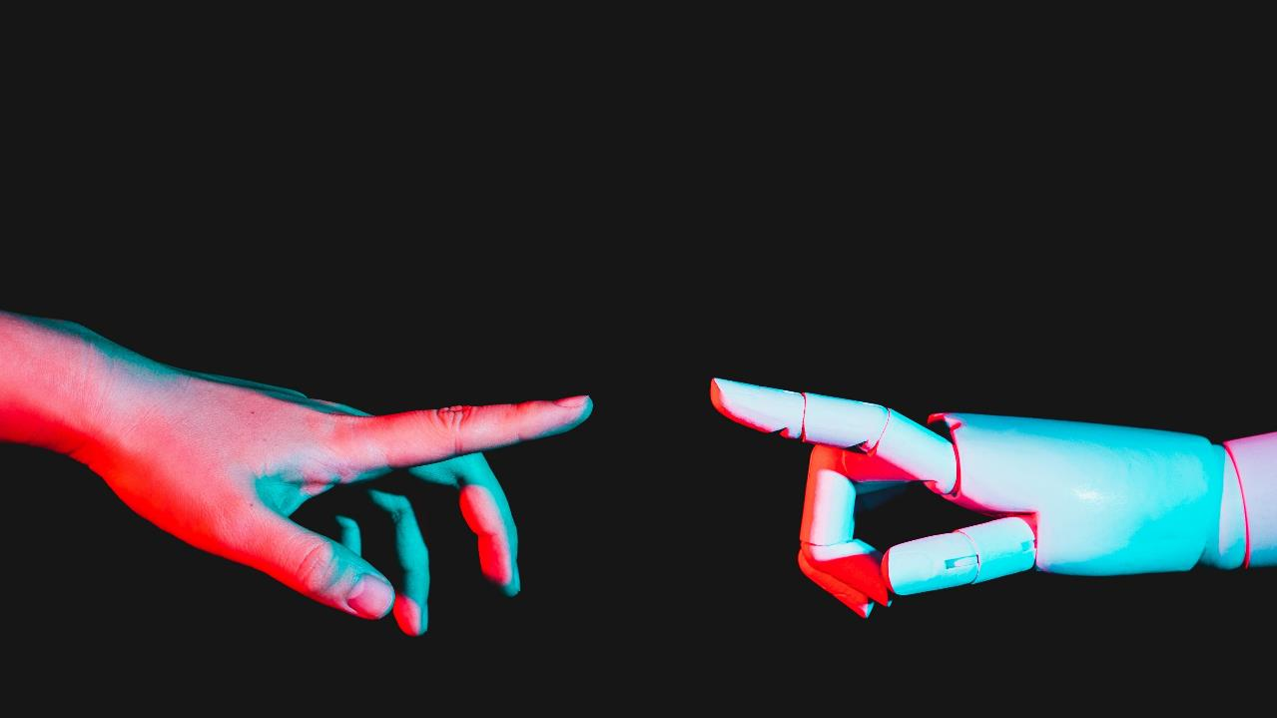

Project title:
Institute of Emerging Career
Presented by:
Muhammad Sufyan
Guided by:
Muhammad Usama

Slide 2

IEC Institute of Emerging Career
Start your Journey with IEC & Be Inspired

Slide 3




Project Overview
Unique
First to market
Tested
Authentic
Only Institute specifically dedicated for youth empowerment
First learn, then earn and then contribute to empower youth
Regular testing and tasks giving sessions on weekly basis.
Regular sessions of students with mentors who are authentic freelancers.

Slide 4

About us
IEC is on a mission to transform the livelihood of underprivileged youth of Pakistan. By quality education model we will prepare thousands of jobs for them, freelance work or start their own startup. We help businesses grow and nurture a consumer-first mindset.

Slide 5

Business Model
MODEL​
Our business model is DTMA. That there is not any advance payment. Every student will after the completion of courses when he/she will be able to earn.​
Abstract​
We believe people need new management tools to help their businesses and startups.
Research​
We based our research on market trends and software sales ​

Slide 6

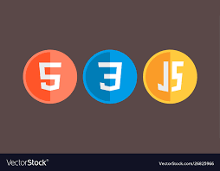
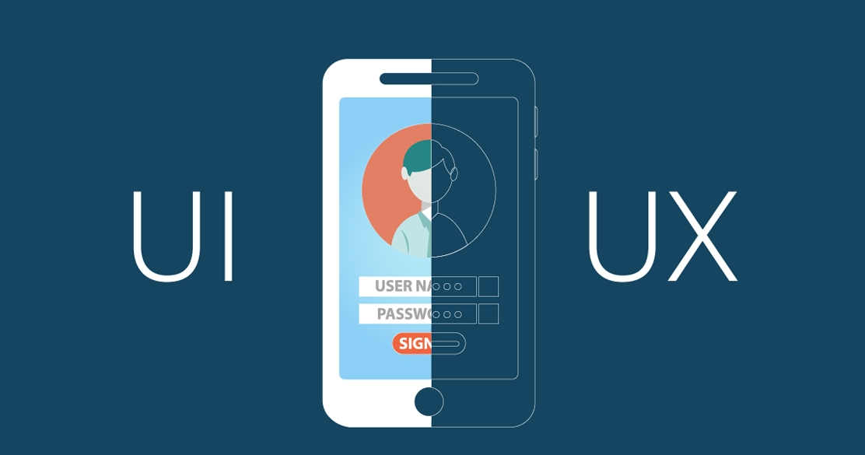

Courses at IEC:
Web development is the work involved in developing a website for the Internet.
User interface design or user interface engineering is the design of user interfaces for machines and software, such as computers, home appliances, mobile devices
​
Data science is an interdisciplinary field that uses scientific methods, processes, algorithms and systems to extract knowledge.
​

Slide 7
Facilities at iec
We facilitate our students to feel like home.
Bootcamp
Follow-up sessions
Financial aid
Bootcamp by IEC is one of the comprehensive, clear, engaging and up-to-date courses to learn essential skills.
These sessions are organized to check the progress of students. Moreover, If a student have then it is also discussed in this session.
We provide students with financial aid.

Slide 8
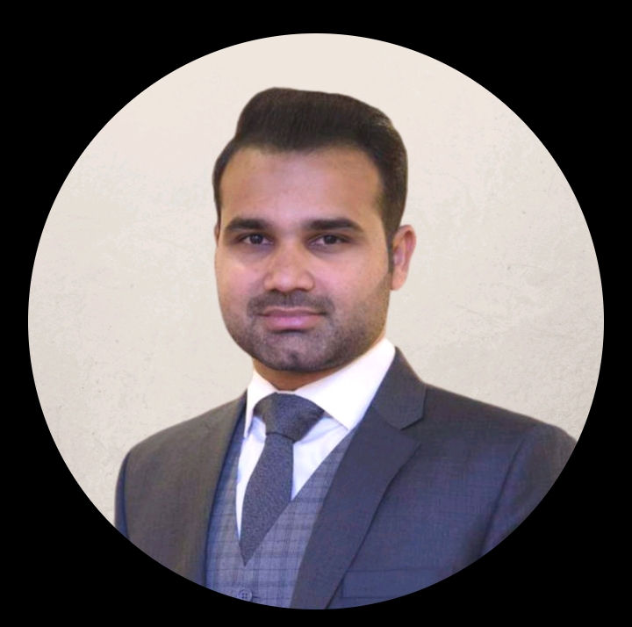
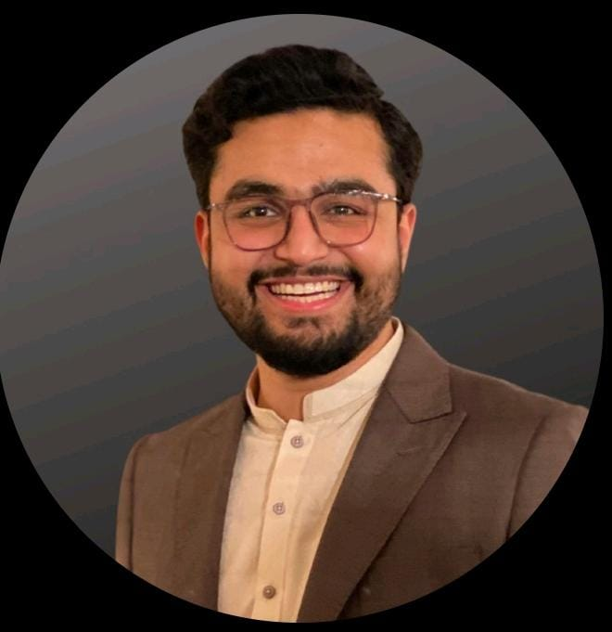
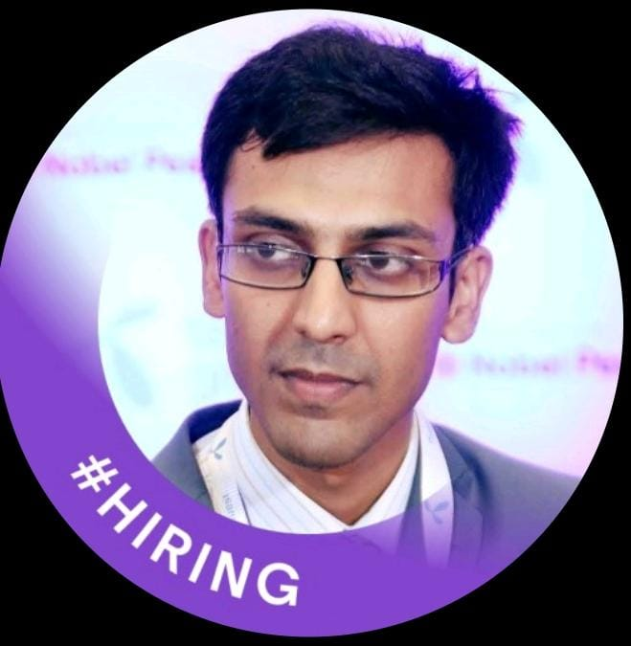
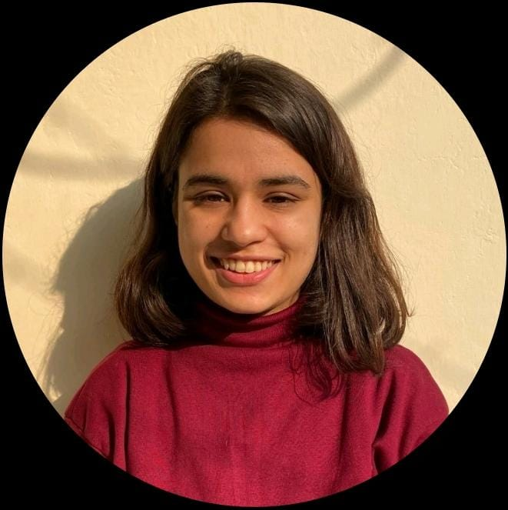
Meet the team
Bilal Afzal khan​​
Danish khan​​
Syed ommer​
Mahek fatima
President​
Entrepreneur, Designing Specialist
Content Specialist, Partnership Manager, EdTech​
Academic Advisor​

Slide 9
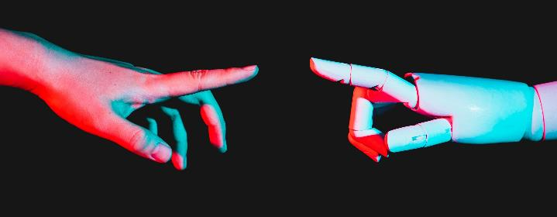
Student feedbacks:
Danial:​
Farzeen:
There is a plenty to do at IEC.
Simple and easy to use app and website, compared to the complex tools.
Affordability is the main draw.
Know wat you’re passionate about?​
If you cannot find something that suits you here, we challenge ourselves to start a new.

Slide 10

Summary
At IEC, we believe in giving 100%. By empowering the youth on task management and using the latest technology, we help businesses grow and nurture a consumer-first mindset. We thrive because of our market knowledge and a great team behind our product. As our CEO says, "Efficiencies will come from proactively transforming how we do business."

Slide 11

Problem
responsive website:
Idea:
Lack of information:
I was confused that on which idea I should make website.
I felt difficulty to make my website responsive.
I was busy with my finals of University and that’s why I was completely blank about capstone project.
Use of git & Github:
Self-reliance:
I was so confused that how I will be able to develop a complete website without the help of others.
I was completely blank about Git & GitHub. So, I lost my whole to upload my project on GitHub.

Slide 12
Solution
Tried my best:
Co-ordination with friends:
I tried my best to make my website responsive and I see a lot of videos from youtube and from other platforms. But I still was not able to make it responsive, but now I am not guilty about myself because I tried my best to learn about it.
I contacted with my friends of Iec and they helped me a lot about capstone project.
Motivation:
Session with mehak mam:
As, I was nervous, but I motivated myself if others can make then why I cannot develop a website, present it.
Discussion session with Mehak mam and the believe of Mehak mam on me further motivated me to keep my struggle continue.

Slide 13

Thank you
Muhammad Sufyan
Web Development Cohort 1
sufyanjhujh706@gmail.com
Proud to be a student of IEC.

